Slide 1
Module 3
Classification and prediction

Slide 2
Classification
Classification consists of assigning a class label to a set of unclassified cases.
1. Supervised Classification
The set of possible classes is known in advance.Super vised classification is known as classification
2. Unsupervised Classification
Set of possible classes is not known. After classification we can try to assign a name to that class. Unsupervised classification is called clustering.

Slide 3
There are two forms of data analysis that can be used for extracting models describing important classes or to predict future data trends.
These two forms are as follows −
Classification
Prediction

Slide 4
Classification vs. Prediction
Classification
predicts categorical class labels (discrete or nominal)
classifies data (constructs a model) based on the training set and the values (class labels) in a classifying attribute and uses it in classifying new data
Prediction
models continuous-valued functions, i.e., predicts unknown or missing values
Typical applications
Credit approval
Target marketing
Medical diagnosis
Fraud detection

Slide 5
Examples
classification
A bank loans officer needs analysis of her data in order to learn which loan applicants are “safe” and which are “risky” for the bank
A marketing manager at AllElectronics needs data analysis to help guess whether a customer with a given profile will buy a new computer
prediction
Suppose that the marketing manager would like to predict how much a given cus-tomer will spend during a sale at AllElectronics

Slide 6
Classification—A Two-Step Process
1. Model constrUction ( Learning step or training phase)
2. Model usage ( Classification )

Slide 7
Model constrction ( Learning step or training phase)
In the first step, a model is built describing a predetermined set of data classes or concepts.
This is the learning step (or training phase), where a classification
algorithm builds the classifier by analyzing or “learning from” a
training set made up of database tuples and their associated class labels.

Slide 8
Model usage or Classification
The model is used for classification.
Test data is used to estimate the the accuracy of classification rules
If the accuracy of the classifier is considered acceptable, the
classifier can be used to classify future data tuples for which the class label is not known.

Slide 9
Process (1): Model Construction
Classification
Algorithms
Training
Data
Classifier
(Model)
IF rank = ‘professor’
OR years > 6
THEN tenured = ‘yes’

Slide 10
Process (2): Using the Model in Prediction
Classifier
Testing
Data
Unseen Data
(Jeff, Professor, 4)
Tenured?

Slide 11
Supervised vs. Unsupervised Learning
Supervised learning (classification)
Supervision: The training data (observations, measurements, etc.) are accompanied by labels indicating the class of the observations
New data is classified based on the training set
Unsupervised learning (clustering)
The class labels of training data is unknown
Given a set of measurements, observations, etc. with the aim of establishing the existence of classes or clusters in the data

Slide 12
Issues regarding classification and prediction
Issues in Data Preparation
Data cleaning
Relevance analysis (feature selection)
Data transformation and reduction

Slide 13
Issues: Data Preparation
Data cleaning
Preprocess data in order to reduce noise and handle missing values
Relevance analysis (feature selection)
Remove the irrelevant or redundant attributes
Data transformation
Generalize and/or normalize data

Slide 14
Evaluation criteria for classification and prediction
Accuracy
Speed
Robustness
Scalability
Interpretability
Other measures, e.g., goodness of rules, such as decision tree size or compactness of classification rules

Slide 15
Issues: Evaluating Classification Methods
Accuracy
classifier accuracy: predicting class label
predictor accuracy: guessing value of predicted attributes
Speed
time to construct the model (training time)
time to use the model (classification/prediction time)
Robustness: handling noise and missing values
Scalability: ability to construct the classifier or predictor efficiently given large amounts of data
Interpretability
understanding and insight provided by the model
Other measures, e.g., goodness of rules, such as decision tree size or compactness of classification rules

Slide 16
Decision tree
It is a supervised learning technique
Decision tree algorithm can be used for solving regression and classification problems
A decision tree is a flowchart-like tree structure,
where each internal node (nonleaf node) denotes a test on an attribute,
each branch represents an outcome of the test,
each leaf node (or terminal node) holds a class label.
The topmost node in a tree is the root node.

Slide 17
Entropy
The degree to which a subset of examples contains only a single class is known as purity, and any subset composed of only a single class is called a pure class.
Informally, entropy3 is a measure of “impurity” in a dataset.
Sets with high entropy are very diverse and provide little information about other items that may also belong in the set, as there is no apparent commonality.
Entropy is measured in bits.
If there are only two possible classes, entropy values can range from 0 to 1.
For n classes, entropy ranges from 0 to log2(n).
In each case, the minimum value indicates that the sample is completely homogeneous, while the maximum value indicates that the data are as diverse as possible, and no group has even a small plurality.

Slide 18

Definition of entropy
Consider a segment S of a dataset having c number of class labels. Let pi be the proportion of
examples in S having the i th class label. The entropy of S is defined as

Slide 19
Information Gain
Information gain is based on the decrease in entropy after a dataset is split on an attribute.
Looking for which attribute creates the most homogeneous branches
Information Gain IG(A) tells us how much uncertainty in S was reduced after splitting set S on attribute A

Slide 20
What is an ID3 Algorithm?
ID3 stands for Iterative Dichotomiser 3
It is a classification algorithm that follows a greedy approach by selecting a best attribute that yields maximum Information Gain(IG) or minimum Entropy(H).

Slide 21
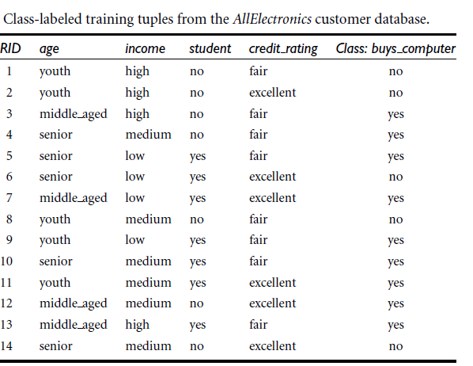
Training data

Slide 22
Training data
Features-
Age
Income
Student
Credit_rating
Target class
Yes
no

Slide 23
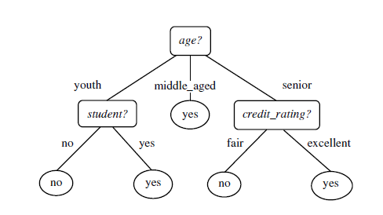
Decision tree

Slide 24
Types of Decision Trees
There are two main types of decision trees that are based on the target variable, i.e.,
Categorical variable decision trees (Classification trees)
Decision Tree which has a categorical target variable then it called a Categorical variable decision tree.
Continuous variable decision trees. (Regression trees)
Decision Tree has a continuous target variable(numeric) then it is called Continuous Variable Decision Tree.

Slide 25
Working of Decision Tree
The root node feature is selected based on the results from the Attribute Selection Measure(ASM).
The ASM is repeated until there is a leaf node or a terminal node where it cannot be split into sub-nodes.

Slide 26
Decision Tree Algorithms
ID3 (Iterative Dichotomiser) algorithm
–Developed by J. Ross Quinlan
–During the late 1970s and early 1980s
C4.5 algorithm
–Quinlan later presented C4.5 (a successor of ID3)
–Became a benchmark to which newer supervised Decision Tree
–Became a benchmark to which newer supervised learning algorithms are often compared.
–Commercial successor: C5.0
CART (Classification and Regression Trees) algorithm
–The generation of binary decision trees
–Developed by a group of statisticians

Slide 27
Algorithm for Decision Tree construction
Basic algorithm (a greedy algorithm)
Tree is constructed in a top-down recursive divide-and-conquer manner
At start, all the training examples are at the root
Attributes are categorical (if continuous-valued, they are discretized in advance)
Examples are partitioned recursively based on selected attributes
Test attributes are selected on the basis of a heuristic or statistical measure (e.g., information gain)

Slide 28
The algorithm is called with three parameters:
D, attribute list, and Attribute selec-tion method.
We refer to D as a data partition.
Initially, it is the complete set of train-ing tuples and their associated class labels.
The parameter attribute list is a list of attributes describing the tuples.
Attribute selection method specifies a heuristic pro-cedure for selecting the attribute that “best” discriminates the given tuples according to class.
This procedure employs an attribute selection measure, such as information gain or the gini index.

Slide 29
The tree starts as a single node, N, representing the training tuples in D
If the tuples in D are all of the same class, then node N becomes a leaf and is labeled with that class .
Otherwise, the algorithm calls Attribute selection method to determine the splitting criterion.
The splitting criterion tells us which attribute to test at node N by deter-mining the “best” way to separate or partition the tuples in D into individual classes

Slide 30
The node N is labeled with the splitting criterion, which serves as a test at the node
A branch is grown from node N for each of the outcomes of the splitting criterion.
There are three possible scenarios,
A is discrete-valued:
A is continuous-valued
A is discrete-valued and a binary tree must be produced
Let A be the splitting attribute.
A has v distinct values, fa₁, a₂, :::, a_{v}g, based on the training data.

Slide 31
A is discrete-valued:
In this case, the outcomes of the test at node N correspond directly to the known values of A.
A branch is created for each known value, a _{j}, of A and labeled with that value
Because all of the tuples in a given partition have the same value for A
so A need not be considered in any future partitioning of the tuples.
Therefore, it is removed from attribute list

Slide 32
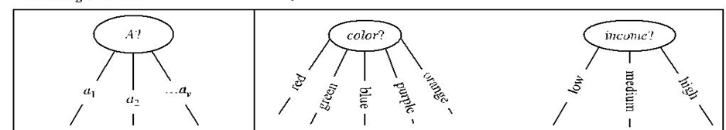

Slide 33
A is continuous-valued
In this case, the test at node N has two possible outcomes, corresponding to the conditions A <=split point and A > split point, respectively
where split point is the split-point returned by Attribute selection method as part of the splitting criterion.
the split-point, a, is often taken as the midpoint of two known adjacent values of A and therefore may not actually be a pre-existing value of A from the training data

Slide 34
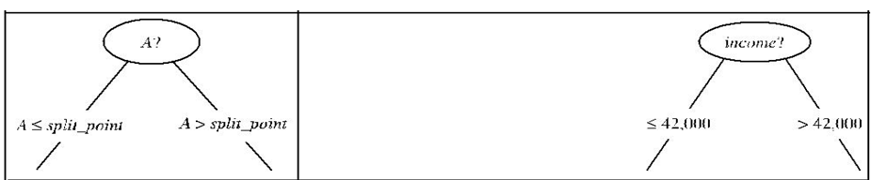

Slide 35
A is discrete-valued and a binary tree must be produced
A is discrete-valued and a binary tree must be produced (as dictated by the attribute selection measure or algorithm being used):
The test at node N is of the form “A ɛ S_{A}?”.
S_{A} is the splitting subset for A, returned by Attribute selection method as part of the splitting criterion.
It is a subset of the known values of A.

Slide 36
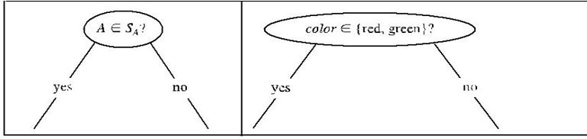

Slide 37
Stopping criteria
The algorithm uses the same process recursively to form a decision tree for the tuples at each resulting partition, D _{j}, of D
The recursive partitioning stops only when any one of the following terminating con-ditions is true:
Conditions for stopping partitioning
All samples for a given node belong to the same class
There are no remaining attributes for further partitioning – majority voting is employed for classifying the leaf
There are no samples left

Slide 38
Attribute Selectiion Measure(ASM)
If the dataset consists of N attributes then deciding which attribute to place at the root or at different levels of the tree as internal nodes is a complicated step.
By just randomly selecting any node to be the root can’t solve the issue.
If we follow a random approach, it may give us bad results with low accuracy.
Attribute Selection Measure determines which features are to be considered as the root node and at each level.

Slide 39
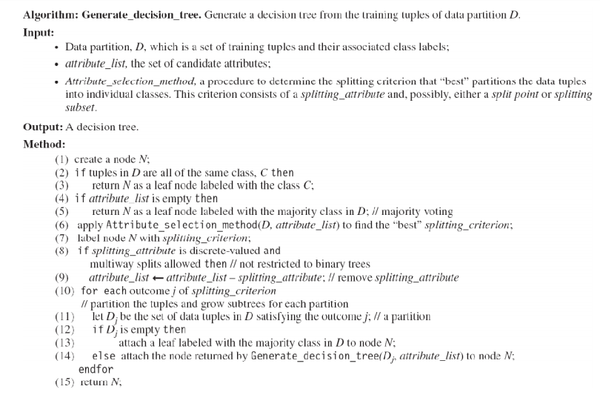

Slide 40
What is Attribute Selective Measure(ASM)?
Attribute selection measures are also known as splitting rules because they determine how the tuples at a given node are to be split.
The attribute selection measure provides a ranking for each attribute describing the given training instances.
The attribute having the best score for the measure is chosen as the splitting attribute (root node) for the given instances.

Slide 41
Types of attribute selection measures
Information gain,
Gain ratio
Gini index.

Slide 42

Gini index
The measure of the degree of probability of a particular variable being wrongly classified when it is randomly chosen is called the Gini index or Gini impurity.
The data is equally distributed based on the Gini index.
Mathematical Formula :
Pi= probability of an object being classified into a particular class.

Slide 43
Gini index
When you use the Gini index as the criterion for the algorithm to select the feature for the root node,the feature with the least Gini index is selected.
This measure is used in the CART algorithm.

Slide 44
Information Gain(ID3)
Entropy is the main concept of this algorithm which helps in determining a feature or attribute that gives maximum information about a class is called Information gain or ID3 algorithm.
Shannon invented the concept of entropy, which measures the impurity of the input set.
In physics and mathematics, entropy referred as the randomness or the impurity in the system.

Slide 45
Information Gain(ID3)
In information theory, it refers to the impurity in a group of examples.
Information gain is the decrease in entropy.
Information gain computes the difference between entropy before split and average entropy after split of the dataset based on given attribute values.
ID3 (Iterative Dichotomiser) decision tree algorithm uses information gain
By using this method we can reduce the level of entropy from the root node to the leaf node.

Slide 46
Information Gain(ID3)
The feature or attribute with the highest ID3 gain is used as the root for the splitting

Slide 47
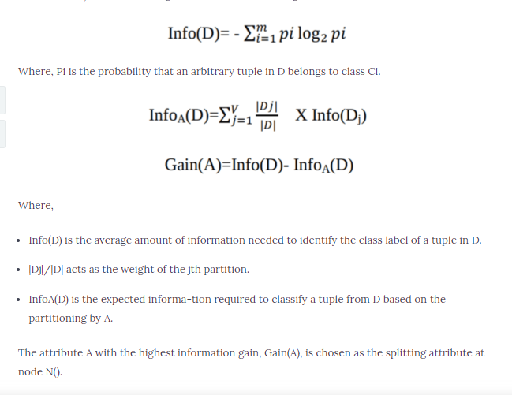
Information Gain
Information Gain(ID3)

Slide 48
Gain ratio
C4.5, an improvement of ID3, uses an extension to information gain known as the gain ratio.
Gain ratio handles the issue of bias by normalizing the information gain using Split Info.
The attribute with the maximum gain ratio is selected as the splitting attribute.
Java implementation of the C4.5 algorithm is known as J48

Slide 49
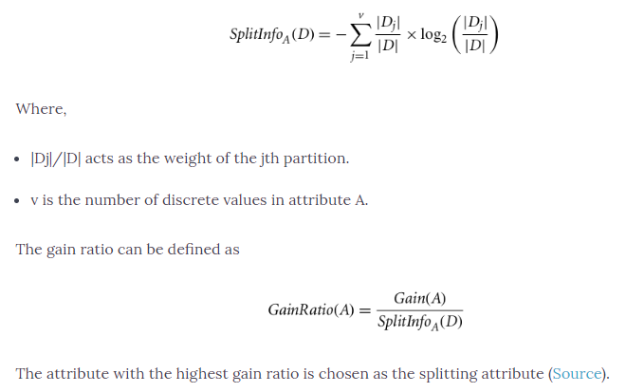
Gain ratio

Slide 50
Gain ratio
C4.5, an improvement of ID3, uses an extension to information gain known as the gain ratio.
Gain ratio handles the issue of bias by normalizing the information gain using Split Info.
Java implementation of the C4.5 algorithm is known as J48, which is available in WEKA data mining tool

Slide 51
Comparing Attribute Selection Measures
The three measures, in general, return good results but
Information gain:
biased towards multivalued attributes
Gain ratio:
tends to prefer unbalanced splits in which one partition is much smaller than the others
Gini index:
biased to multivalued attributes
has difficulty when # of classes is large
tends to favor tests that result in equal-sized partitions and purity in both partitions

Slide 52
Decision tree construction
 | SIZE | COLOR | SHAPE | CLASS
1 | Small | Yellow | Round | A
2 | Big | Yellow | Round | A
3 | Big | Red | Round | A
4 | Small | Red | Round | A
5 | Small | Black | Round | B
6 | Big | Black | Cube | B
7 | Big | Yellow | Cube | B
8 | Big | Black | Round | B
9 | Small | Yellow | Cube | B

Slide 53
Decision tree construction
 | SIZE | COLOR | SHAPE | CLASS
1 | Small | Yellow | Round | A
2 | Big | Yellow | Round | A
3 | Big | Red | Round | A
4 | Small | Red | Round | A
5 | Small | Black | Round | B
6 | Big | Black | Cube | B
7 | Big | Yellow | Cube | B
8 | Big | Black | Round | B
9 | Small | Yellow | Cube | B
Information gain
Size -0.008
Color-0.55
Shape -0.379

Slide 54
COLOR
Yellow
Red
Black

Slide 55
COLOR
yellow
Black
red
SIZE | SHAPE | CLASS
Small | Round | A
Big | Round | A
Big | Cube | B
Small | Cube | B

Slide 56
COLOR
yellow
Black
red
SIZE | SHAPE | CLASS
Small | Round | A
Big | Round | A
Big | Cube | B
Small | Cube | B
SIZE | SHAPE | CLASS
Big | Round | A
Small | Round | A

Slide 57
COLOR
yellow
Black
red
SIZE | SHAPE | CLASS
Small | Round | A
Big | Round | A
Big | Cube | B
Small | Cube | B
SIZE | SHAPE | CLASS
Small | Round | B
Big | Cube | B
Big | Round | B
SIZE | SHAPE | CLASS
Big | Round | A
Small | Round | A

Slide 58
COLOR
yellow
Black
red
SIZE | SHAPE | CLASS
Small | Round | A
Big | Round | A
Big | Cube | B
Small | Cube | B
A
B

Slide 59
COLOR
yellow
Black
red
SHAPE
A
B
Round
Cube

Slide 60
COLOR
yellow
Black
red
SHAPE
A
B
Round
Cube
SIZE | CLASS
Small | A
Big | A

Slide 61
COLOR
yellow
Black
red
SHAPE
A
B
Round
Cube
SIZE | CLASS
Small | A
Big | A
SIZE | CLASS
Big | B
Small | B

Slide 62
COLOR
yellow
Black
red
SHAPE
A
B
Round
Cube
A
B

Slide 63
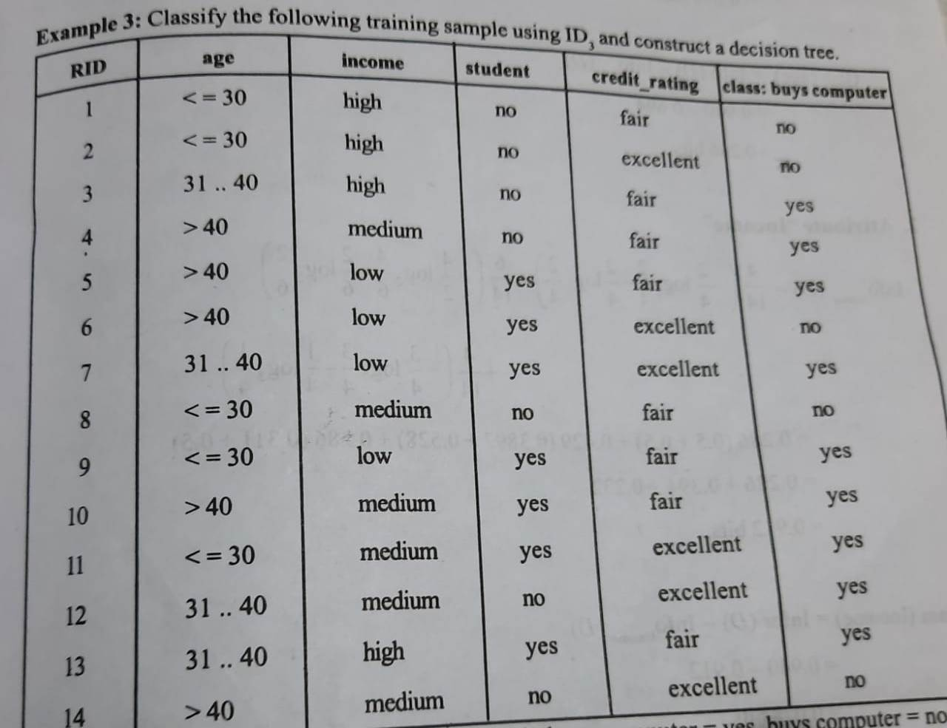
Decision tree construction –eg 2
Information gain
Age -0.246
Income-0.028
Student-0.153
Credit rating-0.048

Slide 64
Calculation of information gain
Information gain is defined as the difference between information needed before splitting and information needed after splitting
–The attribute that has the highest information gain among the attributes is selected as the splitting attribute.
Gain(A)=Info(D) –InfoA (D)
Info(D) is the average amount of information needed to identify the class label of an instance in D.
InfoA (D) is the information needed to identify a class label in D based on partitioning by A

Slide 65

Calculation of information gain
Gain(A)=Info(D) –InfoA (D)
Pi is the probability that a tuple in D belongs to class Ci

Slide 66
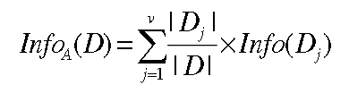
Calculation of information gain
Gain(A)=Info(D) –InfoA (D)
Dj /D is the weight of the jth partition

Slide 67
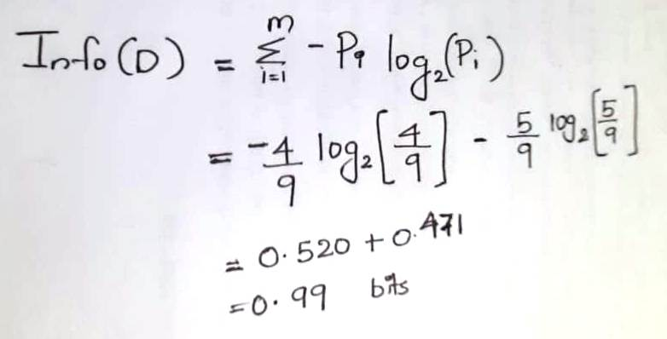
Calculation of Info(D)

Slide 68
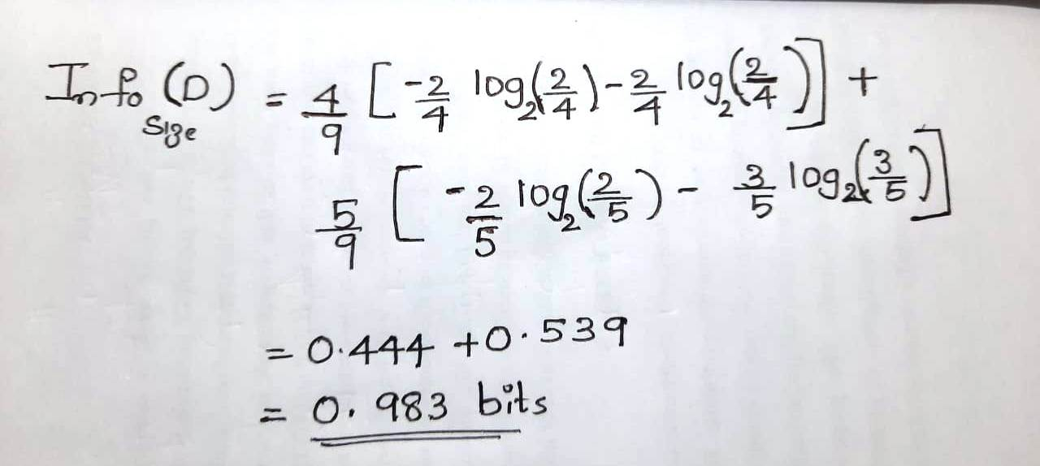
Attribute size- Infosize(D)

Slide 69
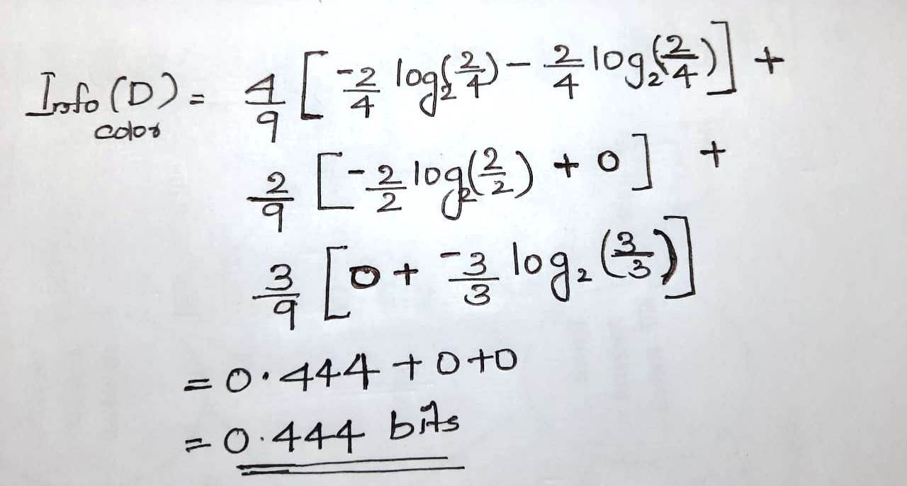
Attribute color- Infocolor(D)

Slide 70
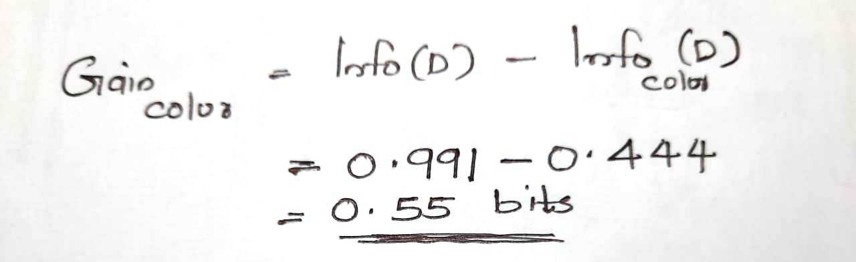
Gain(color)

Slide 71
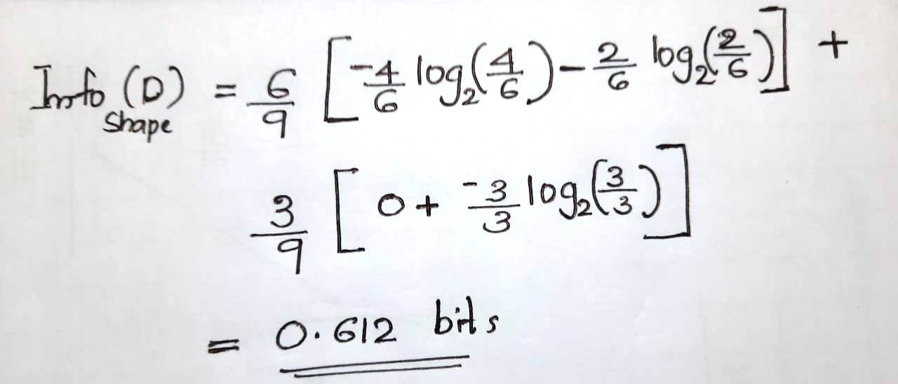
Attribute shape- Infoshape(D)

Slide 72
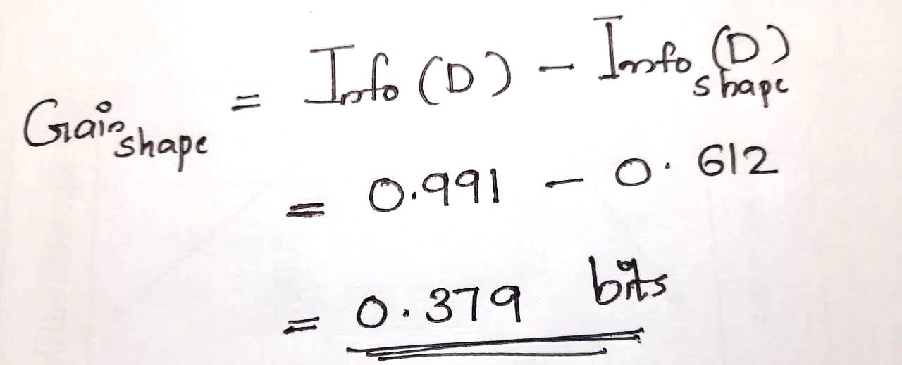
Gain(shape)

Slide 73
Decision tree construction –eg 2
Information gain
Age -0.246
Income-0.028
Student-0.153
Credit rating-0.048

Slide 74
C4.5
C4.5 is an algorithm used to generate a decision tree
Developed by Ross Quinlan.
C4.5 is the successor to ID3 and removed the restriction that features must be categorical by dynamically defining a discrete attribute (based on numerical variables) that partitions the continuous attribute value into a discrete set of intervals.

Slide 75
C4.5
C4.5 made a number of improvements to ID3.
Some of these are:
Handling both continuous and discrete attributes
Handling training data with missing attribute
Pruning trees after creation
Be more robust in the presence of noise.

Slide 76
C4.5
C4.5 made a number of improvements to ID3.
Some of these are:
Handling both continuous and discrete attributes –
In order to handle continuous attributes, C4.5 creates a threshold and then splits the list into those whose attribute value is above the threshold and those that are less than or equal to it.]
Handling training data with missing attribute values –
C4.5 allows attribute values to be marked as ? for missing. Missing attribute values are simply not used in gain and entropy calculations.
Handling attributes with differing costs or weights.
Pruning trees after creation –
C4.5 goes back through the tree once it's been created and attempts to remove branches that do not help by replacing them with leaf nodes.

Slide 77
Difference between id3 and C4.5
Ability to handle attributes with discrete or continuous type.
Ability to handle empty attribute (missing value).
Can do pruning on branches.
Avoiding overfitting
Can Convert trees to rules
The selection is done using a calculation attribute Gain Ratio.

Slide 78
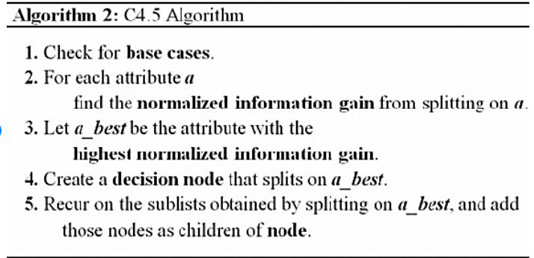
C4.5 Algorithm
This algorithm has a few base cases.
All the samples in the list belong to the same class. When this happens, it simply creates a leaf node for the decision tree saying to choose that class.
None of the features provide any information gain. In this case, C4.5 creates a decision node higher up the tree using the expected value of the class.
Instance of previously-unseen class encountered. Again, C4.5 creates a decision node higher up the tree using the expected value.

Slide 79
Advantages of decision tree
–The construction of decision tree classifiers does not require any domain knowledge or parameter setting.
–Decision trees can handle high dimensional data.
–Easy to interpret for small-sized trees
–The learning and classification steps of decision tree Decision Tree
–The learning and classification steps of decision tree induction are simple and fast.
–Accuracy is comparable to other classification techniques for many simple data sets
–Convertible to simple and easy to understand classification rules

Slide 80
University questions -decision tree

Slide 81
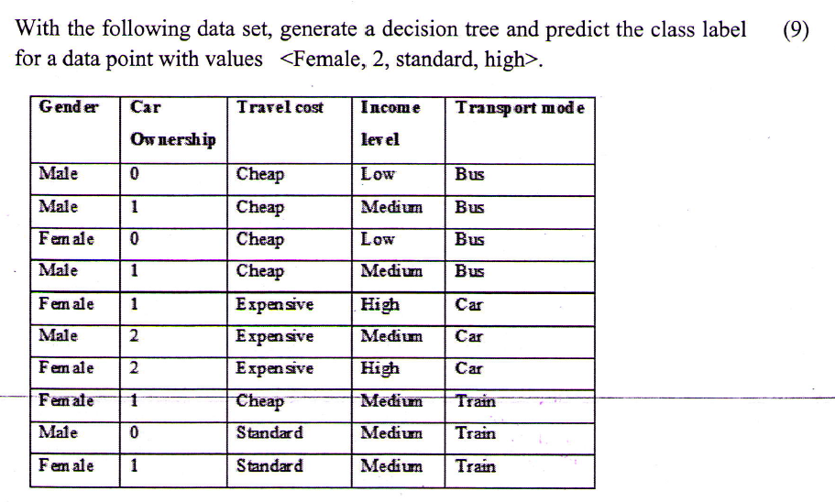

Slide 82
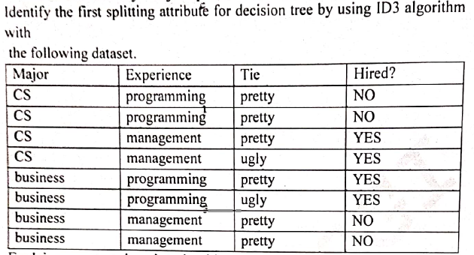

Slide 83
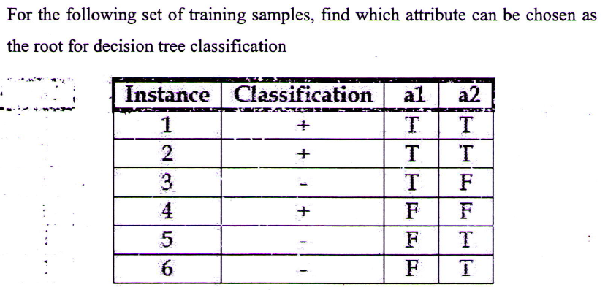

Slide 84

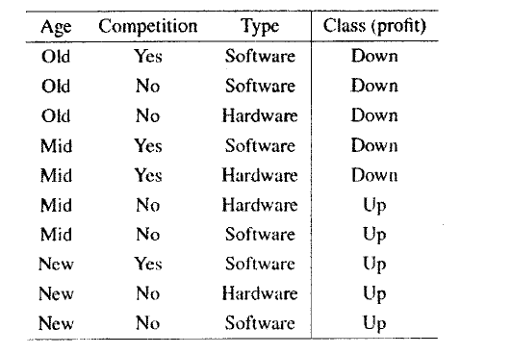

Slide 85
Advantages of decision tree
–The construction of decision tree classifiers does not require any domain knowledge or parameter setting.
–Decision trees can handle high dimensional data.
–Easy to interpret for small-sized trees
–The learning and classification steps of decision tree Decision Tree
–The learning and classification steps of decision tree induction are simple and fast.
–Accuracy is comparable to other classification techniques for many simple data sets
–Convertible to simple and easy to understand classification rules

Slide 86
Issues in decision tree learning
Avoiding overfitting of data
Problem of missing attributes

Slide 87
Avoiding overfitting of data
A machine learning algorithm is said to be overfitted, when we train it with a lot of data.
When a model gets trained with so much of data, it starts learning from the noise and inaccurate data entries in our data set.
Then the model does not categorize the data correctly, because of too much of details and noise.

Slide 88
Avoiding overfitting of data
In case of ID3 algorithm, it grows each branch of the tree just deeply enough to perfectly classify the training examples.
But it can lead to difficulties when there is noise in the data, or when the number of training examples is too small to produce a representative sample of the true target function.

Slide 89
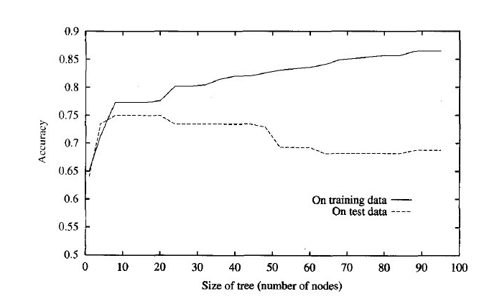
Impact of overfitting
Illustrates the impact of overfitting in a typical decision tree learning.
From the figure, we can see that the accuracy of the tree over training examples increases monotonically
whereas the accuracy measured over independent test samples first increases then decreases.

Slide 90
Approaches to avoiding overfitting-Pruning
The main approach to avoid overfitting is pruning.
Pruning is the procees of adjusting decision tree to reduce misclassification error
It is a technique that reduces the size of decision trees by removing sections of the tree that provide little power to classify instances.
Pruning reduces the complexity of the final classifier, and hence improves predictive accuracy by the reduction of overfitting

Slide 91
Types of pruning
There are several approaches to apply pruning in decision tree learning.
These can be grouped into two classes:
- Post-pruning (recovery):
- Pre-pruning (avoidance):

Slide 92
Post-pruning (recovery):
Allow the tree to overfit the data, and then post-prune the tree
Grow decision tree to its entirety.
Trim the nodes of the decision tree in a bottom-up fashion.
Postpruning is done by replacing the node with leaf.
If error improves after trimming, replace sub- tree by a leaf node.

Slide 93
Pre-pruning (avoidance):
Also known as early stopping rule
Stop growing the tree earlier, before it reaches the point where it perfectly classifies the training data
Prepruning is the halting of subtree construction at some node after checking some measures.
These measures can be Information gain, Gini index,etc.
If partitioning the tuple at a node would result in a split that falls below a prespecified threshold, then pruning is done.
Pre-pruning may stop the growth process prematurely.

Slide 94
REDUCED ERROR PRUNING
The idea is to hold out some of the available instances—the “pruning set” after the tree is built.
Split data into training set and pruning set.
Decision tree is constructed using training set.
These pruning set are not used for building the decision tree, they provide an estimate of its error rate on future instances than the training data.

Slide 95
REDUCED ERROR PRUNING
Reduced error pruning is done in bottom up fashion.
Prune the tree until the classification error on these independent instances starts to increase.
Criteria: If error of parent is lesser than its child then prune the tree else not .
i.e if Parent (error)< Child(error) then “Prune”
else don’t Prune

Slide 96
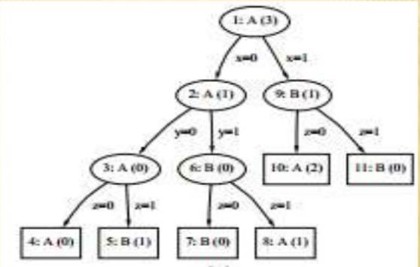
Reduced error pruning –working

Slide 97
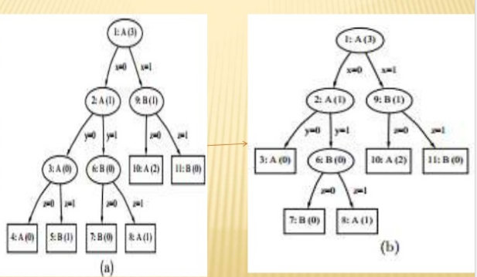
Reduced error pruning –working

Slide 98
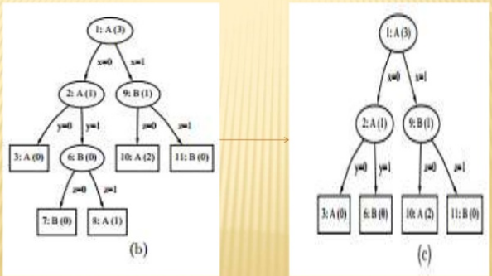
Reduced error pruning –working

Slide 99
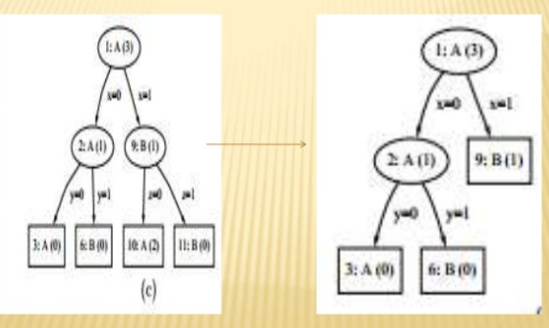
Reduced error pruning –working

Slide 100
Reduced error pruning
STEPS
In each tree, the number of instances in the pruning data that are misclassified by the individual nodes are given in parentheses.
Assuming that the tree is traversed left-to-right.
The pruning procedure first considers for removal the subtree attached to node 3.
Because the subtree’s error on the pruning data (1 error) exceeds the error of node 3 itself (0errors), node 3 is converted to a leaf.
Next, node 6 is replaced by a leaf for the same reason

Slide 101
Reduced error pruning
Having processed both of its successors, the pruning procedure then considers node 2 for deletion.
However, because the subtree attached to node 2 makes fewer mistakes (0 errors) than node 2 itself (1 error), the subtree remains in place.
Next, the subtree extending from node 9 is considered for pruning, resulting in a leaf
In the last step, node 1 is considered for pruning, leaving the tree unchanged.

Slide 102
COMPARISION
Prepruning is faster than post pruning since it don’t need to wait for complete construction of decision tree.
But still Post-pruning is preferable to pre-pruning because of “interaction effect”.
These are the effects which arise after interaction of several attributes.
Prepruning suppresses growth by evaluating each attribute individually, and so might overlook effects that are due to the interaction of several attributes and stop too early.
Post- pruning, on the other hand, avoids this problem because interaction effects are visible in the fully grown tree

Slide 103
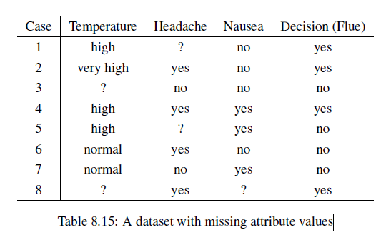
Problem of missing attributes
Table shows a dataset with missing attribute values. the missing values are indicated by “?”.

Slide 104
Problem of missing attributes
The following are some of the methods used to handle the problem of missing attributes.
Deleting cases with missing attribute values
Replacing a missing attribute value by the most common value of that attribute
Assigning all possible values to the missing attribute value
Replacing a missing attribute value by the mean for numerical attributes
Assigning to a missing attribute value the corresponding value taken from the closest t cases, or replacing a missing attribute value by a new value

Slide 105
Regression trees
A regression problem is the problem of determining a relation between one or more independent variables and an output variable which is a real continuous variable and then using the relation to predict the values of the dependent variables.
Regression problems are in general related to prediction of numerical values of variables.
Trees can also be used to make such predictions.
A tree used for making predictions of numerical variables is called a prediction tree or a regression tree.

Slide 106
CART(Classification and Regression trees)
Decision Tree model where the target values have a discrete nature is called classification models.
A discrete value is a finite or countably infinite set of values, For Example, age, size, etc.
The models where the target values are represented by continuous values are usually numbers that are called Regression Models.
Continuous variables are floating-point variables.
These two models together are called CART.
CART uses Gini Index as Classification matrix.

Slide 107
The main elements of CART are:
Rules for splitting data at a node based on the value of one variable
Stopping rules for deciding when a branch is terminal and can be split no more
A prediction for the target variable in each terminal node

Slide 108
CART Algorithm for Classification
The tree will be constructed in a top-down approach as follows: Step 1: Start at the root node with all training instances Step 2: Select an attribute on the basis of splitting criteria Step 3: Partition instances according to selected attribute recursively
Partitioning stops when: There are no examples left All examples for a given node belong to the same class There are no remaining attributes for further partitioning – majority class is the leaf

